Slide 1

Applied Artificial Intelligence
Time Series Analysis and Forecasting
Presented By:
Raj Khona 11013310
Karan Dulloo 11013650
Presented to Professor: Ziegler, Simon and Moeckel, Gerd

Slide 2
PROBLEM STATEMENT
New York City Energy Consumption Analysis and Prediction
This scenario focuses on energy demand forecasting where the goal is to predict the future load on an energy grid. it is a critical business operation for companies in the energy sector as operators need to maintain the fine balance between the energy consumed on a grid and the energy supplied to it.
Too much power supplied to the grid can result in waste of energy and would overwhelm the system. However, if too little power is supplied it can lead to blackouts, leaving customers without power.
This dataset includes hourly power demand for New York City for a period of about 5.5 years.

Slide 3
SOLUTION OVERVIEW
After detailed data analysis we got to know that data has multiple seasonalities (yearly, weekly) so as to deal with this situation we came up with an idea to use 3 phase plan to capture the effect of multiple seasonality on data.
Approach 1: We resampled data in monthly format to capture yearly seasonality and trained ARIMA model on it. Since ARIMA is not able to deal with multiple seasonalities very well we used this approach.
Approach 2: However, if we resample data on a monthly level we might loose pattern in data, so as to deal with this we resampled our data on daily level and added a additional predictor using Facebook Prophet as it works really good on multiple seasonalities and gave us good forecast.
Approach 3: We have resample data to check the accuracy and forecast some values from the same dataset using CNN (Convolution Neural Network) as CNN in the recent research has proven to be more efficient.

Slide 4
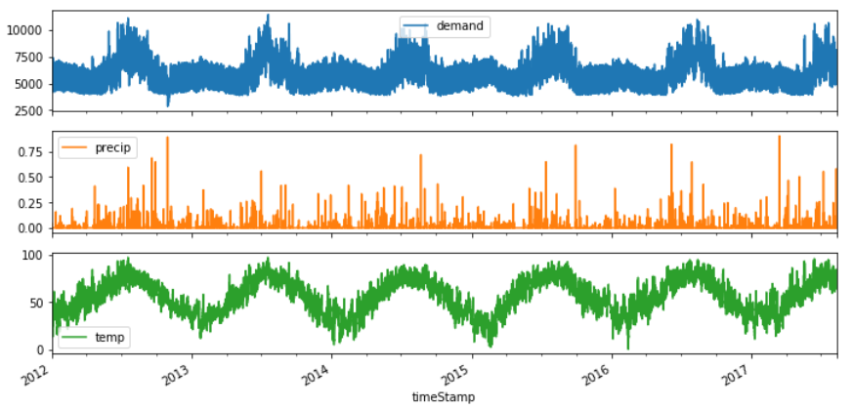
EXPLORATORY DATA ANALYSIS
Viewing this plot we can see signs of seasonalities also a correlation between variables

Slide 5
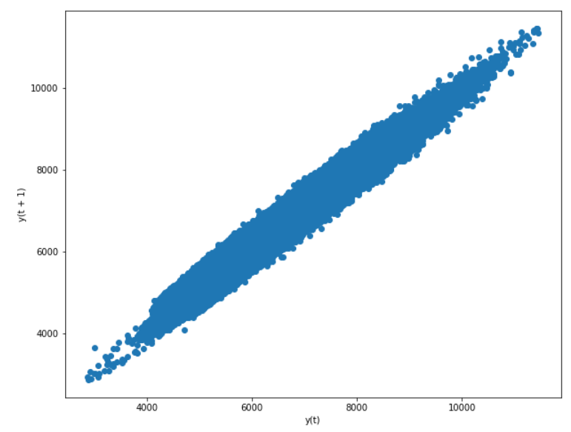
LAGGED PLOTS
Helps us to see the number of significant lags of autocorrelation. This can not often be established just by looking at a time plot.
Also gives us an estimate of the lag autocorrelation, which indicates the strength of the correlation.

Slide 6
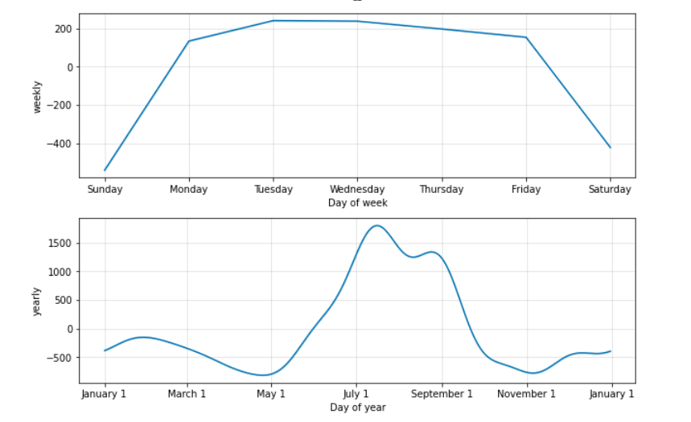
SEASONALITIES IN DATA

Slide 7
DATA PRE-PROCESSING
Handling missing values.
Identifying and removing outliers.
Min- Max Scaling used for normalization.
Resampling Data to handle multiple seasonalities.

Slide 8
ARIMA OVERVIEW
It is an acronym for Auto Regressive (AR) Integrated (I) Moving Average (MA) which indicates that an ARIMA model has three components to it.
ARIMA models can be expressed in two forms: Non-seasonal models where the model exhibits an order in the form of (p,d,q) where: p = The order of the Auto-Regressive Model d = The order of differencing q = The order of the Moving Average
Auto-Regressive Models (AR): Auto-regressive models are similar to a regression model but the regressor in this case is the same dependent variable with a specific lag.
Differencing (I): For ARIMA to perform at its best it needs the data to be stationary. That means that the mean and variance are constant over the entire set. Differencing is used to transform the data so that it is stationary
Moving Average (MA): Moving averages are widely used in time series analysis and is an already well-known concept. It involves getting the average of the points in a series for a specific lag and can be expressed like:

Slide 9
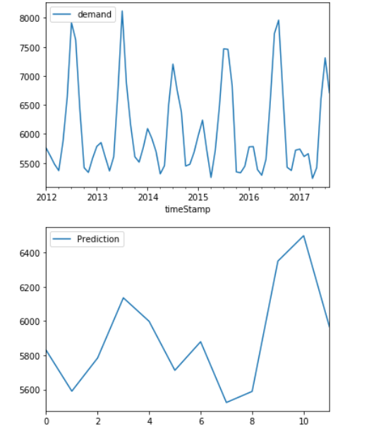
ARIMA FORECAST

Slide 10
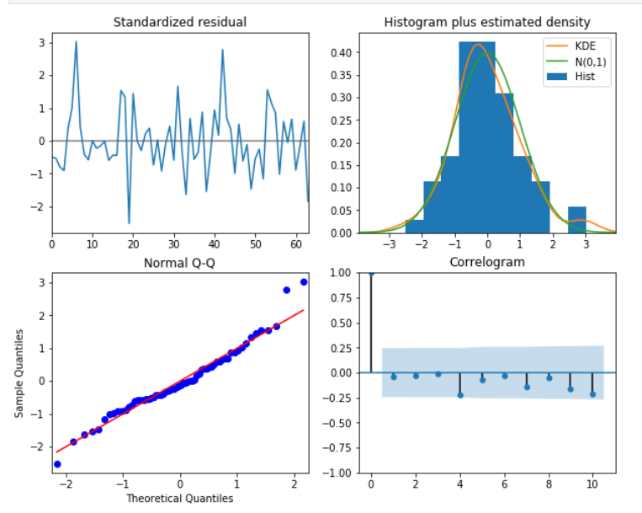
ARIMA RESIDUAL ANALYSIS

Slide 11
CNN OVERVIEW
One of the variant used heavily in the field of Computer Vision.
Used in image classification problems in 2D input.
Perform all the action and consists of several layers.
Input Data
Conv. Layer
Pooling
Output

Slide 12
CNN FOR TIME SERIES
This same process can be implemented on 1D sequences of data.
The model learns to perform the process on input values.
Main benefit of using this classification is that they can learn from the raw time series data directly.
Y
Dataset
Preprocessing
ConvLayer
Y^
Comparison
Accuracy

Slide 13
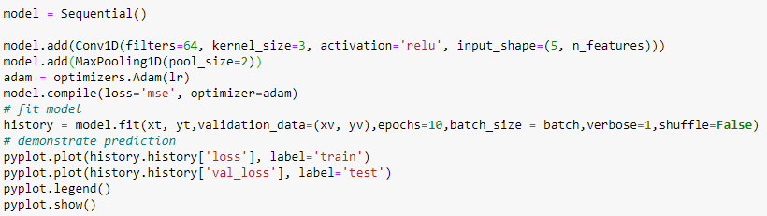
CONVOLUTIONAL LAYER
Null values were dropped.
Outliers were removed using Z score.
Min- Max Scaling used for normalization.
ACF and PACF

Slide 14
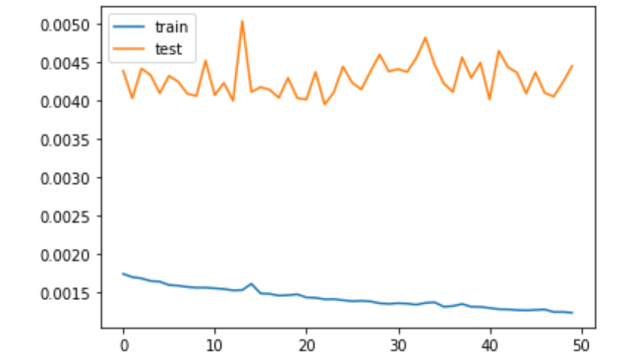
CNN LOSS VALIDATION CHECK

Slide 15
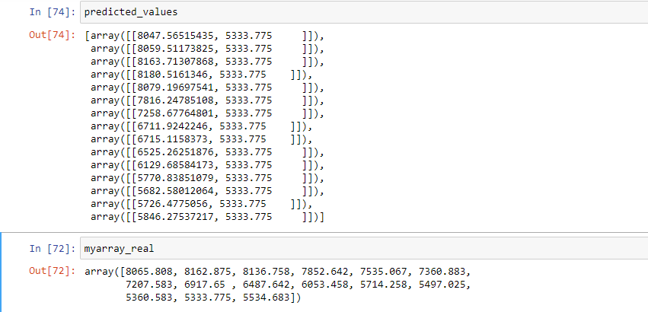
CNN PREDICTION VALUES

Slide 16
FACEBOOK PROPHET OVERVIEW
Prophet is a procedure for forecasting time series data based on an additive model where non-linear trends are fit with yearly, weekly, and daily seasonality, plus holiday effects.
It works best with time series that have strong seasonal effects and several seasons of historical data.
Prophet is robust to missing data and shifts in the trend, and typically handles outliers well.
Advantages:
Accurate and fast.
Fully automatic.
Tunable forecasts.

Slide 17
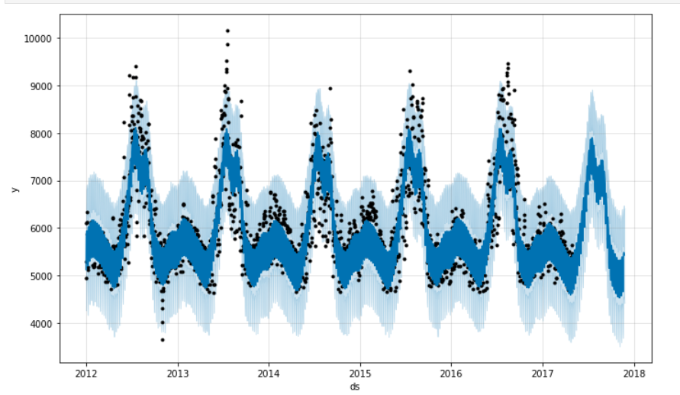
FACEBOOK PROPHET FORECAST

Slide 18
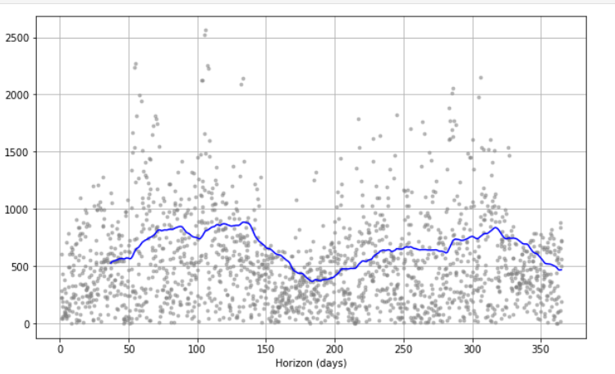
FACEBOOK PROPHET CROSS VALIDATION

Slide 19
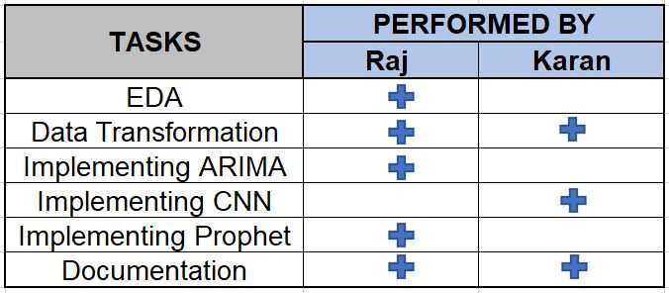
TASK MANAGEMENT

Slide 20
THANK YOU

